Slide 1
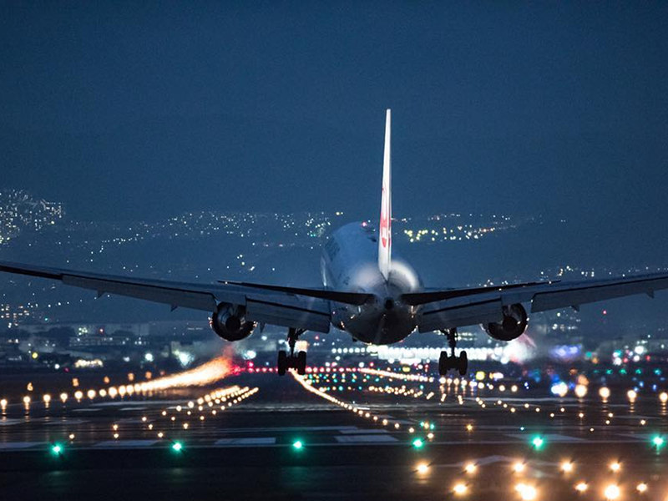
Flight Booking System

Slide 2
Abstract
The project aims to design and implement a web-based air ticket reservation system to provide customers with a hassle-free ticket booking experience. This system was developed using JavaScript, CSS, and HTML as programming languages, with MySQL as the database management system. Agile methodology was adopted for its development. Real-time communication between administrators and users is a key feature, allowing passengers to cancel reservations and view price charts, enhancing the existing system. Passengers can search for available flights between departure and destination cities for specific dates, with details such as flight number, name, price, and duration displayed. After selection, the system checks seat availability and proceeds to book the chosen flight. This system greatly simplifies and improves the air travel reservation process.

Slide 3
Introduction
Online Air Ticketing is a user-friendly platform enabling customers to reserve flight tickets online, offering a convenient and time-saving approach. This project, titled "Design and Implementation of an Air Ticket Reservation System," is adaptable for use by various airlines. The system's features are similar to those of a typical ticketing system. As a user:
You can view flight schedules.
You can reserve tickets.
You can cancel your reservations.
You can confirm your reservations.
This system simplifies the ticket booking process and enhances the overall experience for customers.

Slide 4
Objective
The primary objectives of this air ticket reservation system are:
To simplify the process of air ticket reservations for passengers.
To save valuable time and effort for potential air travelers.
To reduce the overall hassle experienced by users during the booking process.

Slide 5
Methodology
That's a reasonable definition of a methodology. Methodologies are structured approaches or frameworks that provide a set of principles and guidelines on how to conduct research, gather information, or perform tasks efficiently and effectively within a specific domain or subject matter. They help ensure consistency and rigor in various processes, whether it's research, project management, or problem-solving.

Slide 6
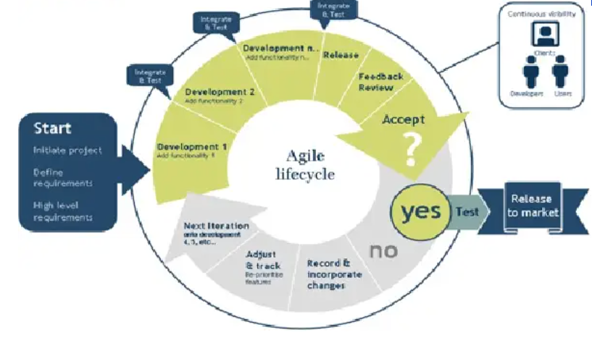
Agile Method
An Agile process is characterized by the division of tasks into short phases of work and frequent iterations. It promotes adaptive planning, evolutionary development, and encourages rapid and flexible responses to change. In Agile methodologies like Scrum and Kanban, the work is typically divided into small, manageable units, often referred to as sprints or iterations, allowing teams to regularly review progress, adapt to new information, and deliver incremental value to stakeholders. This approach is particularly well-suited to dynamic and complex projects where requirements may evolve during the development process.

Slide 7
Type Of User
Admin
. Creating a flight
. Changing time Schedule
. Creating a naew route
. Updating airport information
. Registering and managing users
. View Statistics
Registered User
. View flight Schedule
. Book,Confirm/Cancel reservation
Unregistered User
.View flight Schedule

Slide 8
Conclusion
The online air ticket reservation system automates the booking of airline tickets, significantly reducing both time consumption and the errors associated with manual processes. In our analysis, we examined various Air Ticket Reservation Systems worldwide and collected features from them. We incorporated the features commonly used in Air Reservation Systems, with some graphical enhancements. Throughout this project, we aimed to provide a variety of user options, making it user-friendly and interactive. This project presents ample opportunities for experimentation and improvement. We welcome any advice or suggestions that can help us enhance this project further.

Slide 9
THANK YOU

